Slide 1

Fault Detection, Diagnosis and Prognosis System (FDDPS)
DMC Hackathon Project

Slide 2
About the Team (CPTDS)
CPTDS
Computational and Predictive Technology and Development System
Diaa Elkott Software Engineer @ Carl Zeiss Industrial Metrology
Surojit Ganguli Mechanical Engineer @ Textron-Greenlee
Cameron Kagy Software Developer @ INTEGRIS Engineering
Taihua Li M.S. in Predictive Analytics Candidate @ DePaul University
Peng Wang Ph.D. in MAE Candidate@ Case Western Reserve University

Slide 3
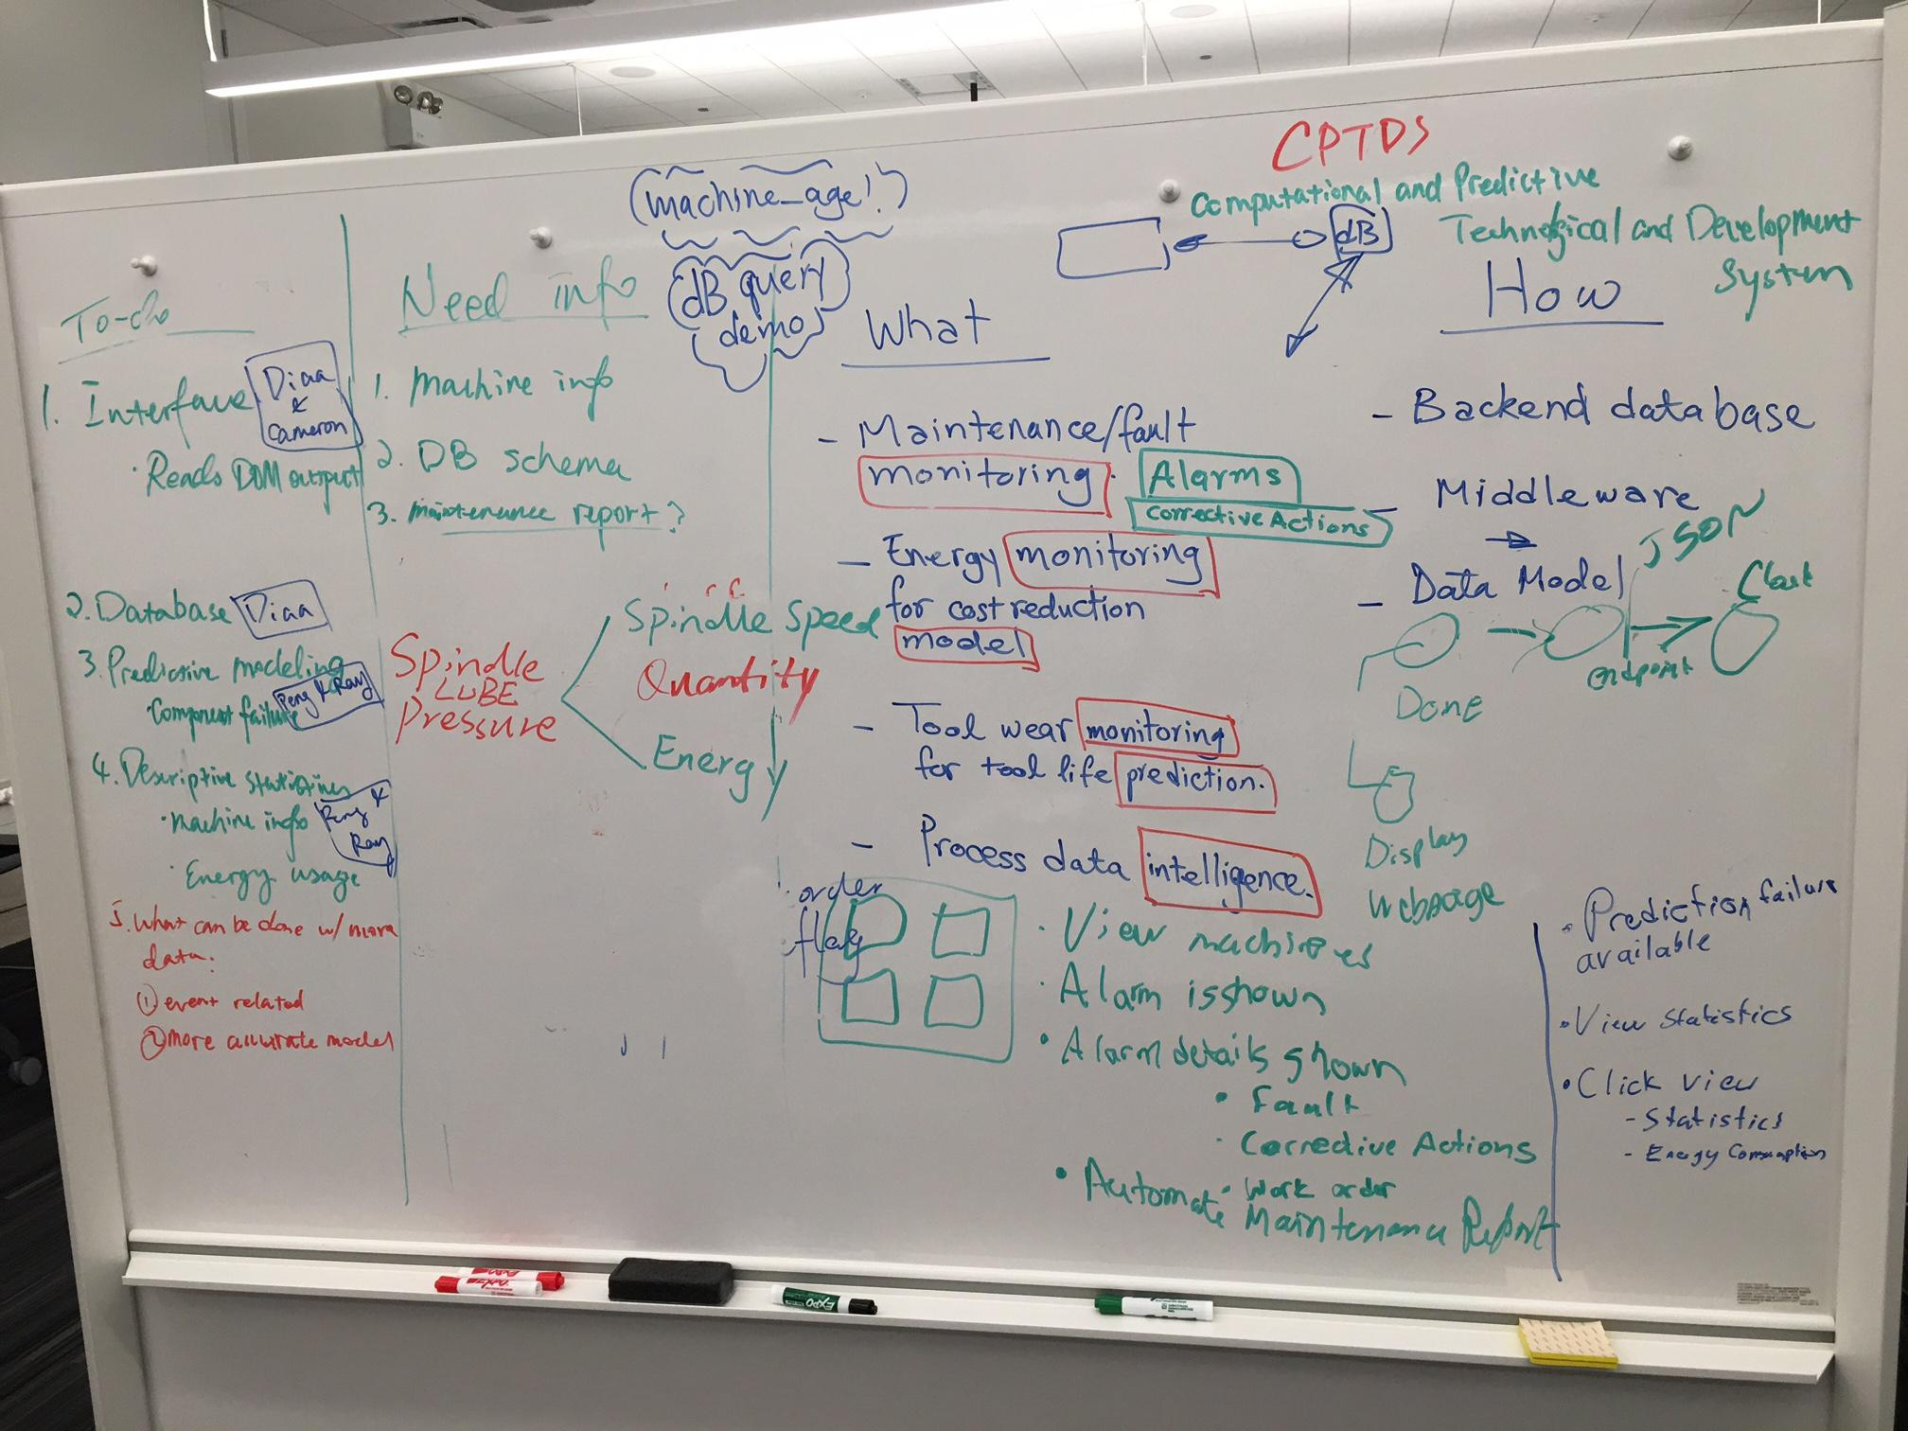
About the Data
2016 dataset [2.76GB]
21 columns x 8.08M rows
75 machines
Only 1 column partially contains numerical data
Metadata & categorical data
Alarm data are more ‘complete’
Industrial problems identified:
Manufacturers panic on the loss of revenue due to unplanned machine downtime
Lack of visibility of machine status
Inefficient troubleshooting

Slide 4
About the Project
A democratized and data-driven approach to monitor, identify and predict machine failure
Goals:
Improve manufacturing competitiveness in the United States
Reduce the loss of revenue by unplanned downtime and maintenance
Increase manufacturing efficiency through reducing failure events
Novelty:
Simplified predictive models of potential machine failure
Utilization of DOME
Cloud hosted graph database
Efficient troubleshooting approach

Slide 5







System Architecture
Database | Modeling | Where things happen | Interface

Slide 6

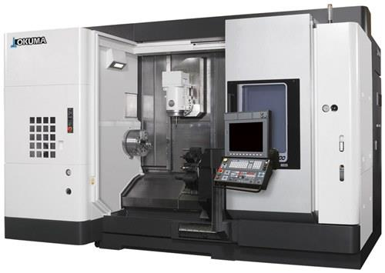



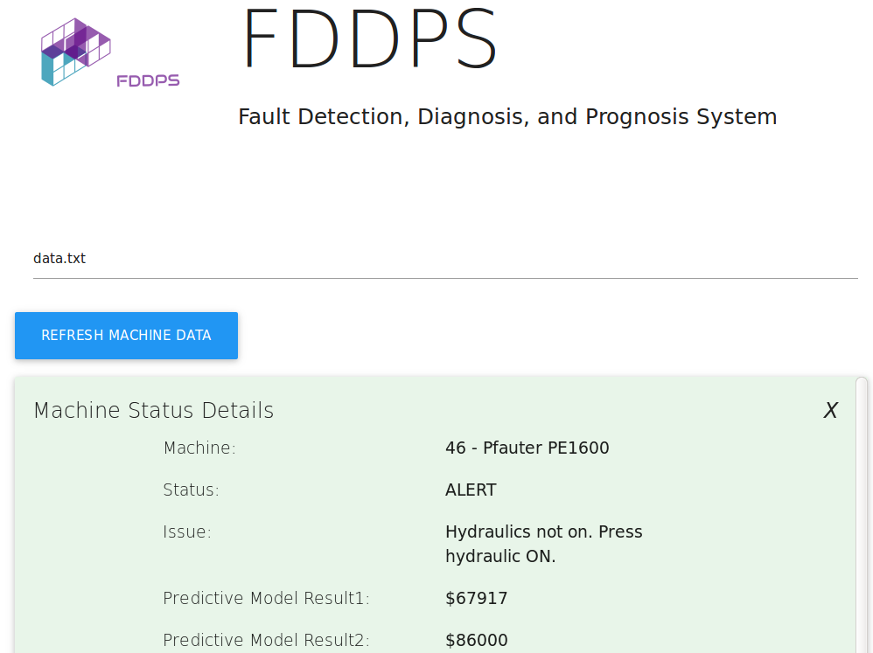

System Architecture
Maintenance
Stochastic Modeling
MTConnect Data
...
Recommender System
Operators

Slide 7
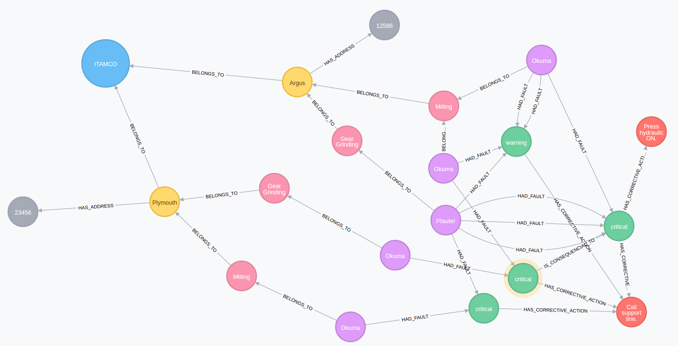
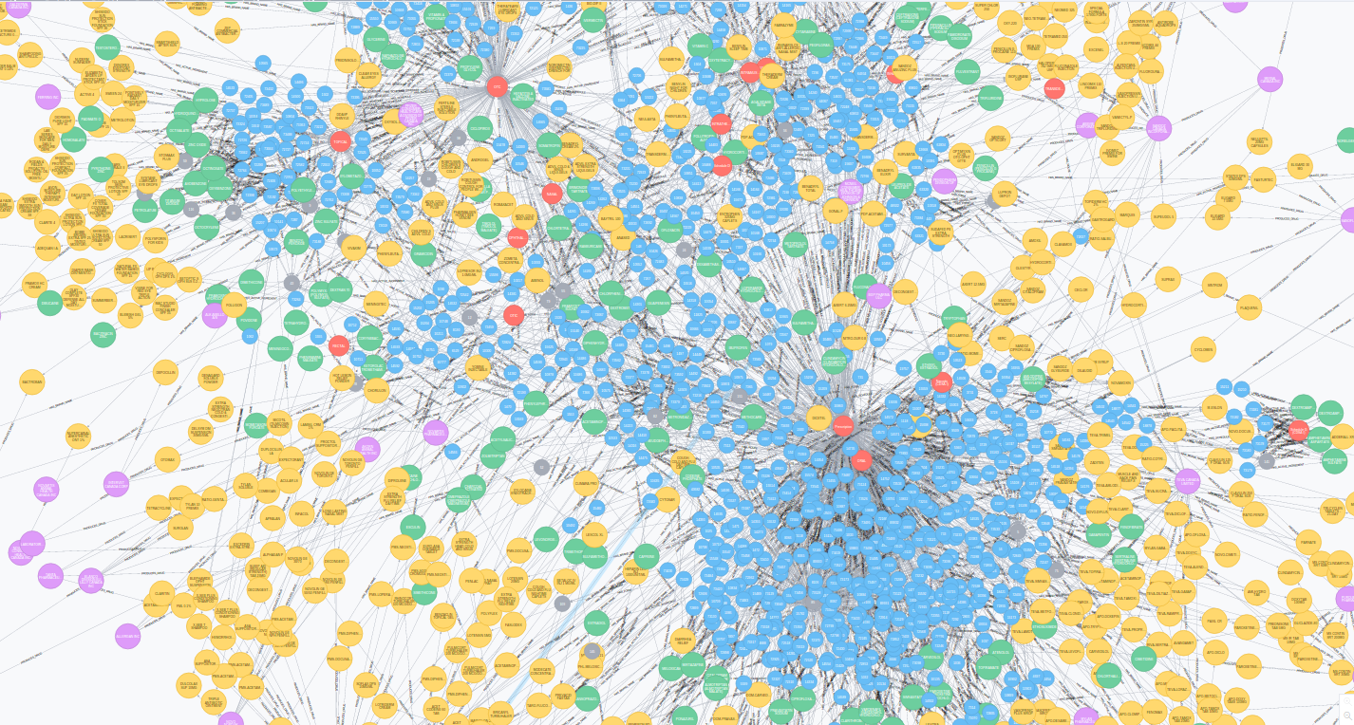
Database
ITAMCO Graph Data Model
Graphical/Social Network Organization

Slide 8
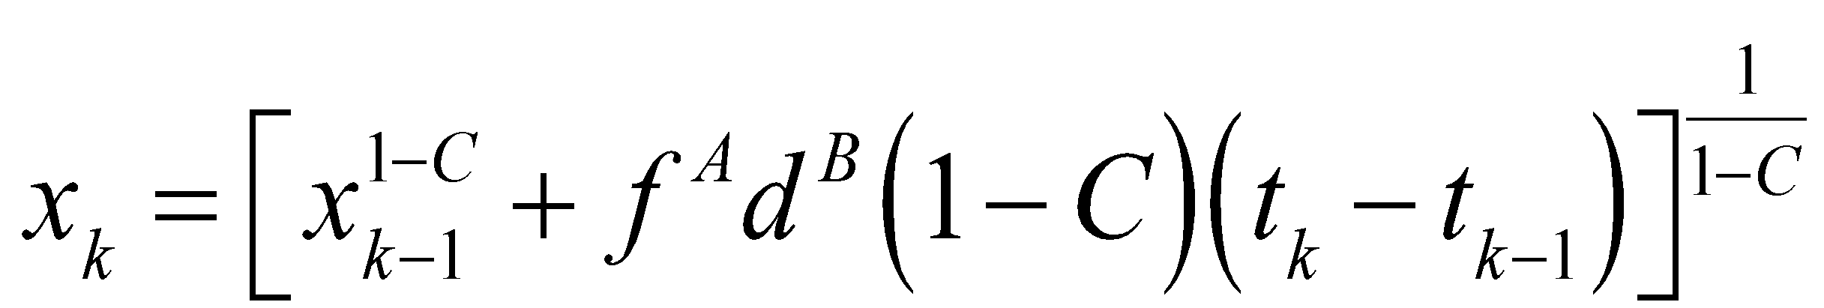
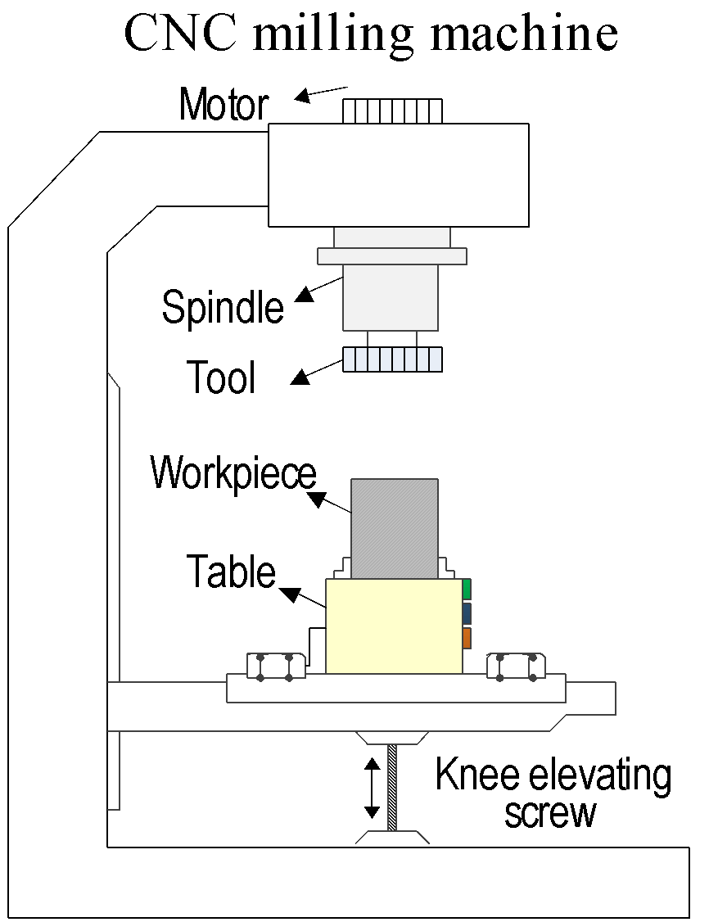
Stochastic Modeling
Tool Wear, x (mm)
Failure threshold
Monitoring
Force
Vibration
Acoustic Emission
Measurements
……
Time, t (Min)
Current time
Predicted probability distribution of wear
*For more sophisticated prediction models, more data regarding machinery usage should be utilized.

Slide 9
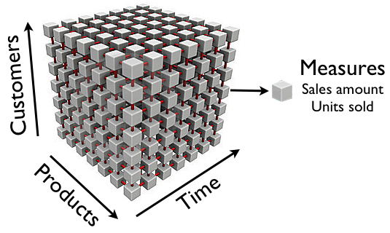
Recommender System
Machine ID | Alarm 1 | Alarm 2 | Alarm 3
46 | 0 | 0 | 0
47 | 41 | 0 | 0
48 | 0 | 0 | 0
One machine data
Machine ID
Usage
Information
Similarity measures: correlation, [euclidean, manhattan, minkovski]*, etc.
*Distance output. Similarity = 1 - distance with normalized data
**For more sophisticated prediction models, more data regarding machinery usage should be utilized.

Slide 10
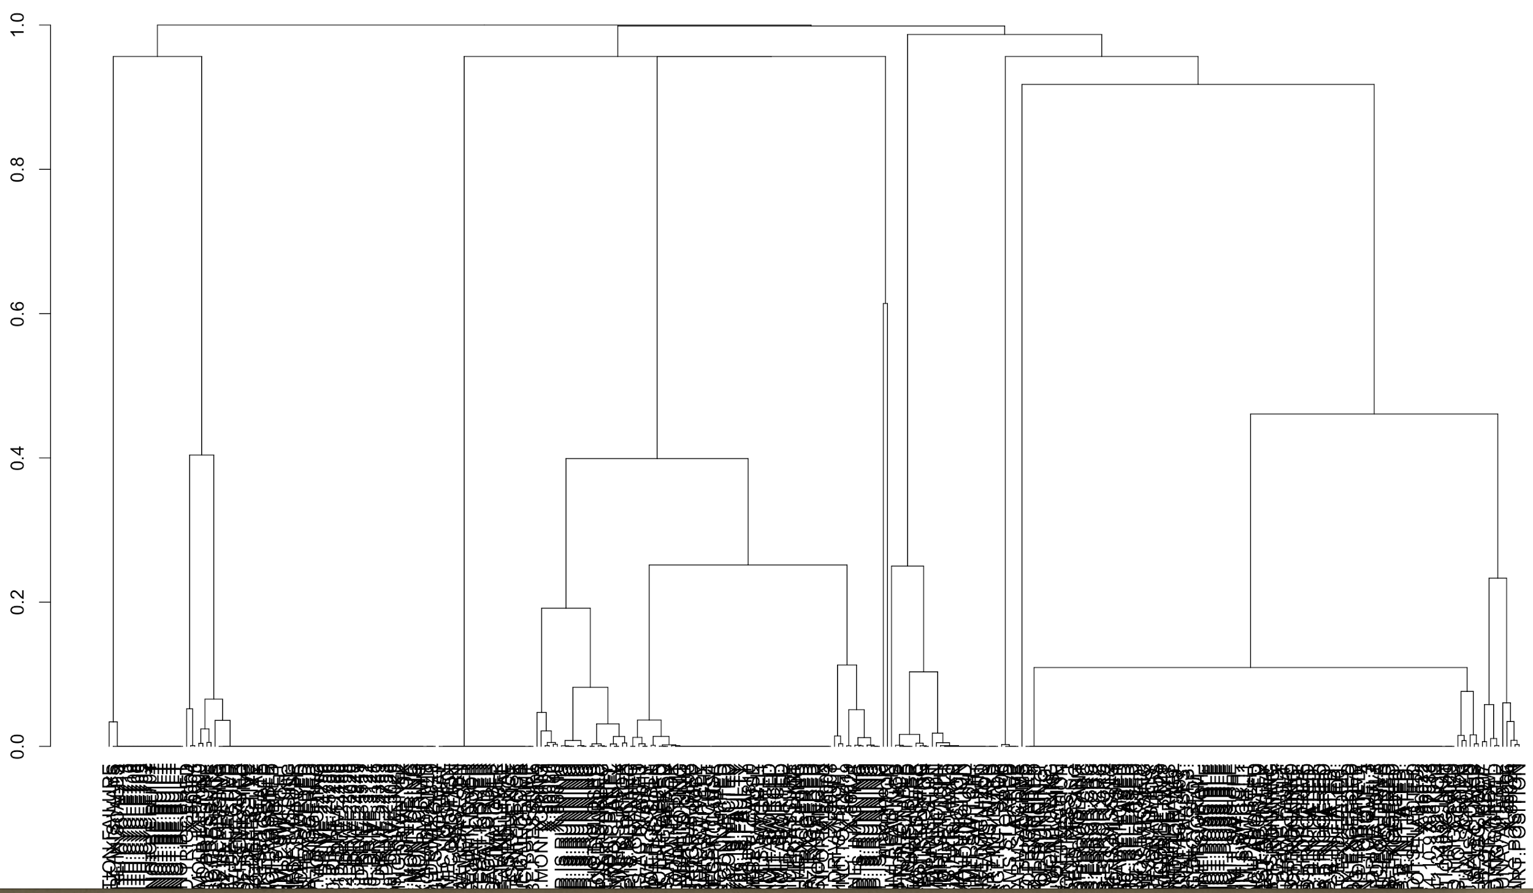
Alarm Patterns
Hierarchical Clustering Params
Sim: correlation
Dis: 1 - abs(correlation)
Complete linkage

Slide 11
Demo
Database
Stochastic model
Interface

Slide 12
Conclusions
Business Viability Web application allows remote monitoring Scalable solution leads to cost reduction Accessibility for small businesses | Innovation Tool wear and fault prediction models Scalable, extensible cloud-hosted graph database Systematic protocol for troubleshooting Automatic maintenance report
Impact Reduce expenditure Improve operation reliability and machine sustainability Business intelligence Data-driven decision making and planning | Use of DMC Utilization of DOME Integrable models written in Python, Matlab Web interface could be easily added to DMC

Slide 13
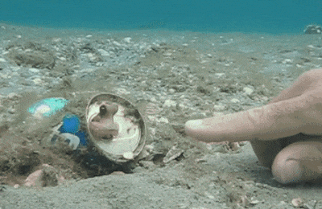
Future Work Ideas
Creation of crowdsourced knowledge base for troubleshooting
StackOverflow for manufacturing
Use NLP to generate troubleshooting protocols accordingly
Sequential data modeling
Online streaming of data and scheduled data mining model update
Integration of Matlab model
...and work with DOME

